Slide 1
Data Storage for Big Data
Prof. Tahar Kechadi
School of Computer Science

Slide 2
Outline
Describe cloud-based storage solution
Describe cloud-based databases
Benefits and limitations
Case studies

Slide 3
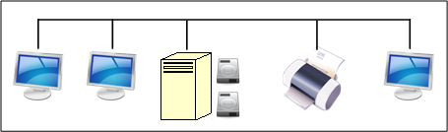
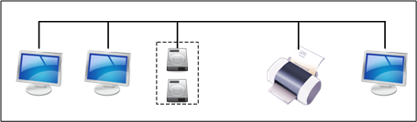
Evolution of Network Storage
File server
  Server with large disk capacity
  Sharing, replication and storage of large files
Storage-area networks (SAN)
  Storage devices connected directly to network
  Network-attached storage (NAS)
Cloud-based Data Storage

Slide 4
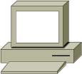
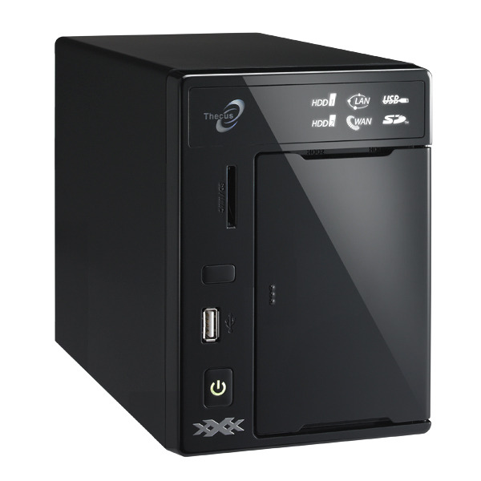

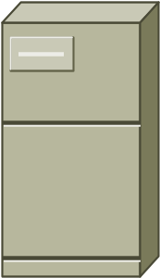
NAS
LAN
Win2k
Linux
Unix
Generic
Generic
Application
Servers
NAS Appliances

Slide 5
SAN Architecture
Interconnection
  Fibre Channel
  iSCSI protocol
    Internet Small Computer System Interface
    Network standard for linking data storage facilities
    Enable the transfer of SCSI packets over a TCP/IP (Ethernet) network
Hard Drives
  The Logical Block Addressing (LBA)
  File Systems

Slide 6

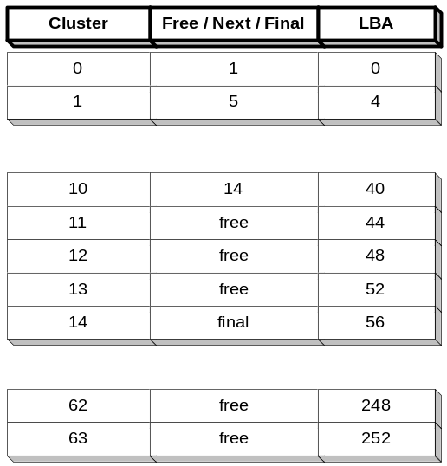
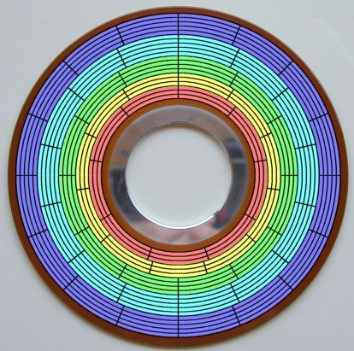
Hard Drive File Systems
FAT (File Allocation Table)
Itisme.txt
…
…

Slide 7
RAIDs
RAID
  Redundant Array of Inexpensive Disks
RAID Access
  Reading/writing information from a set of disks at the same time
Reliability
  Add parity and/or mirroring information on multiple disks of the array
Performance
  Improving performance and/or reliability of the storage device
Configuration
  RAID 0, RAID 1, RAID 2, RAID 3, etc.
Notes:
Disk striping is the process of dividing a body of data into blocks and spreading the data blocks across multiple storage devices, such as hard disks or solid-state drives (SSDs). A stripe consists of the data divided across the set of hard disks or SSDs, and a striped unit, or strip, that refers to the data slice on an individual drive.
RAID arrays appear to the OS as a single logical hard disk. RAID employs the technique of disk mirroring or disk striping, which involves partitioning each drive's storage space into units ranging from a sector (512 bytes) up to several megabytes. The stripes of all the disks are interleaved and addressed in order.
In a single-user system where large records, such as medical or other scientific images, are stored, the stripes are typically set up to be small (perhaps 512 bytes) so that a single record spans all disks and can be accessed quickly by reading all disks at the same time.
In a multi-user system, better performance requires establishing a stripe wide enough to hold the typical or maximum size record. This allows overlapped disk I/O across drives.
RAID 0: This configuration has striping but no redundancy of data. It offers the best performance but no fault-tolerance.
RAID 1: Also known as disk mirroring, this configuration consists of at least two drives that duplicate the storage of data. There is no striping. Read performance is improved since either disk can be read at the same time. Write performance is the same as for single disk storage.
RAID 2: This configuration uses striping across disks with some disks storing error checking and correcting (ECC) information. It has no advantage over RAID 3 and is no longer used.
RAID 3: This technique uses striping and dedicates one drive to storing parity information. The embedded ECC information is used to detect errors. Data recovery is accomplished by calculating the exclusive OR (XOR) of the information recorded on the other drives. Since an I/O operation addresses all drives at the same time, RAID 3 cannot overlap I/O. For this reason, RAID 3 is best for single-user systems with long record applications.
RAID 4: This level uses large stripes, which means you can read records from any single drive. This allows you to use overlapped I/O for read operations. Since all write operations have to update the parity drive, no I/O overlapping is possible. RAID 4 offers no advantage over RAID 5.
RAID 5: This level is based on block-level striping with parity. The parity information is striped across each drive, allowing the array to function even if one drive were to fail. The array’s architecture allows read and write operations to span multiple drives. This results in performance that is usually better than that of a single drive, but not as high as that of a RAID 0 array. RAID 5 requires at least three disks, but it is often recommended to use at least five disks for performance reasons.
RAID 5 arrays are generally considered to be a poor choice for use on write-intensive systems because of the performance impact associated with writing parity information.
When a disk does fail, it can take a long time to rebuild a RAID 5 array. Performance is usually degraded during the rebuild time and the array is vulnerable to an additional
disk failure until the rebuild is complete.
RAID 6: This technique is similar to RAID 5 but includes a second parity scheme that is distributed across the drives in the array. The use of additional parity allows the array to continue to function even if two disks fail simultaneously. However, this extra protection comes at a cost. RAID 6 arrays have a higher cost per gigabyte (GB) and often have slower write performance than RAID 5 arrays.

Slide 8
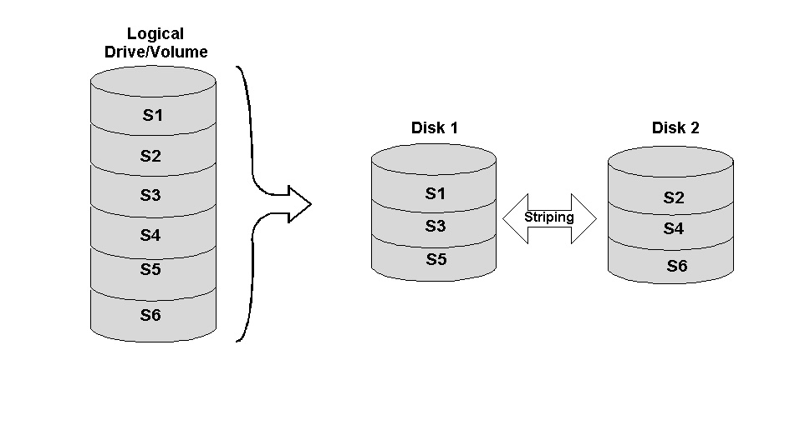
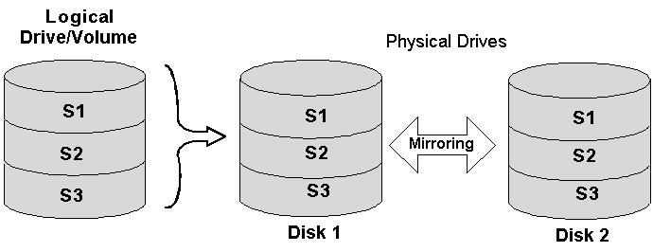
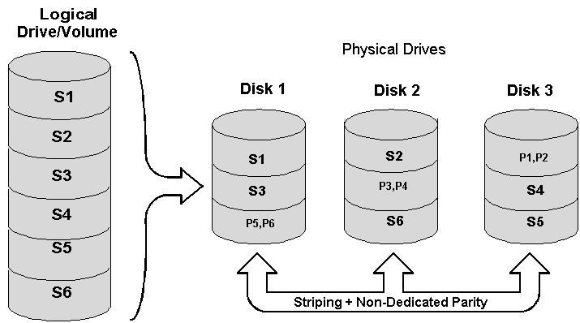
Examples of RAIDs
RAID 0
RAID 1
RAID 5
Notes:
In computers, parity (from the Latin paritas, meaning equal or equivalent) is a technique that checks whether data has been lost or written over when it is moved from one place in storage to another or when it is transmitted between computers.
Parity and RAID: The concept of parity is also used in redundant array of independent disks (RAID) protection. RAID devices use enhanced forms of parity checking such as vertical and horizontal parity. Some RAID groups -- such as RAID 4 or RAID 5 -- have one or more disk drives that contain parity information that allows them to rebuild data if a drive failure occurs. For example, double-parity RAID (also known as RAID 6), stripes data across a set of at least four drives at a block level, like RAID 5, but then writes a second set of parity data across all the drives.

Slide 9
Advantages of SANs
Reliability
  Data striping across multiple volumes
  Reconstruction of the file content
Performance
  Less system overhead
Compatibility
  Support common file systems
Backup
  Ease of performing backups

Slide 10
Cloud-Based Data Storage
Data storage resides in the cloud
Data Access
  Web browser interface
  Mounted disk drive:
    appear locally
  Set of API calls
Examples
  Dropbox, Google Drive, OneDrive, HomePipe, etc.

Slide 11
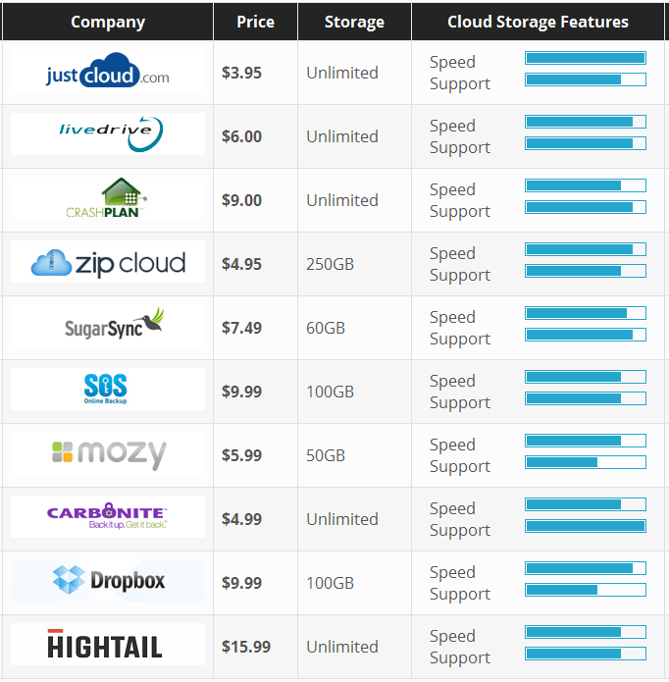
Examples

Slide 12
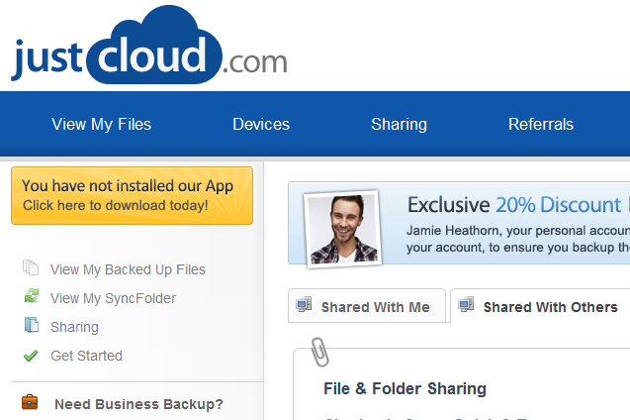
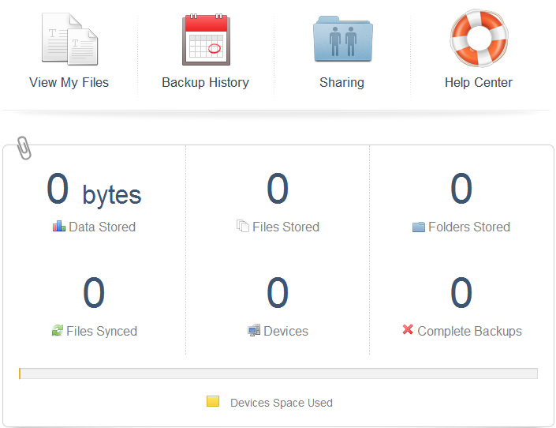
JustCloud
Unlimited Cloud Storage
Access Files Anywhere
Sync Multiple Computers
Share files
Sync Folder, Backup file
Data Security: 256-bit
Mobile Apps, Tracking …
Free Account: 15Mb storage, 50 files, 14 days
Personal, Business accounts

Slide 13
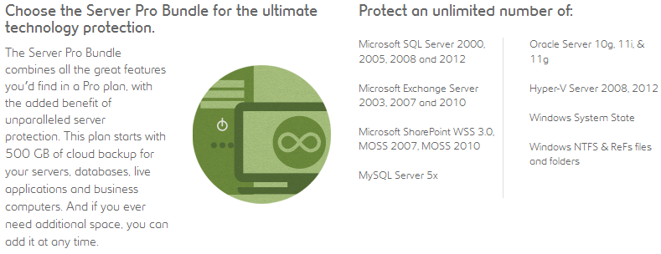
Carbonite
Unlimited Cloud Storage
Access Files Anywhere, Sync Multiple Computers
Share files, Sync Folder, Backup file
Data Security: 128-bit
Free Account: 15days
Personal, Pro, Server

Slide 14
Advantages of using
Cloud-Based Data Storage
Scalability
  Scale storage capacity (up or down)
Pay as you use
Reliability
  Transparent data replication
Ease of access
  Support web-based access
Ease of use
  Remote file storage area -> logical drive

Slide 15
Disadvantages of using
Cloud-Based Data Storage
Performance
  Data accessed over the Internet
Security
  Data in the cloud?
  Encrypt the files, (BoxCryptor)
Data orphans
  Abandon data in cloud storage facilities -> confidential data at risk

Slide 16
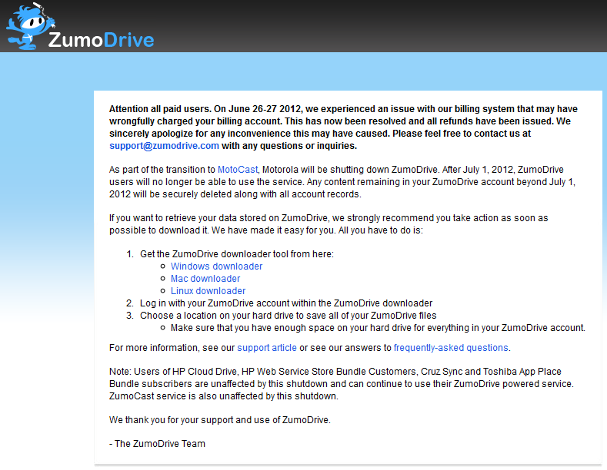
Notes:
Stopped here – 10-10-2016

Slide 17
Cloud-based Backup Systems
Data backup
  Encrypted format
Scheduling
  When backup operations are to occur
Retrieving
  Retrieving backup files easily
Support multi platforms

Slide 18
Industry-Specific: Example
Different data storage and access requirements
Healthcare Industry
  Secure electronic medical records
Example
  MS HealthVault:
    Store medical records, prescriptions, measurements
    Share to GP, healthcare personnel, family members
    Set an expiration date

Slide 19
Understanding File Systems
OS File systems (FS)
  Handling storage, retrieval of files to/from a local disk
  File operations: copy, delete, create, move,…
Network File Systems (NFS)
  Handling files residing on devices across the network
Cloud File Systems (CFS)
  Handling files residing on the cloud

Slide 20
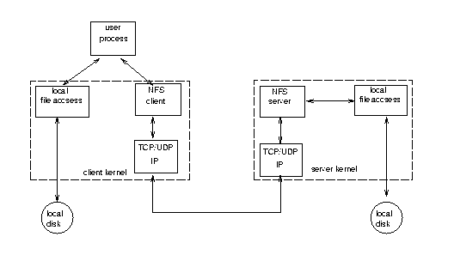
NFS
Network File System

Slide 21
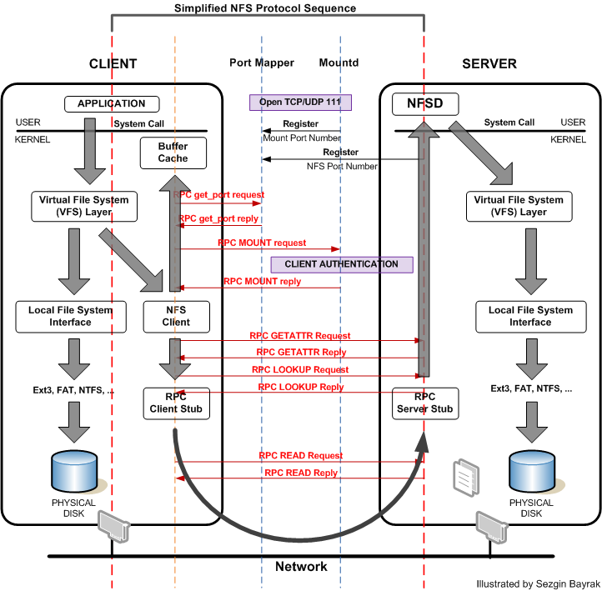
NFS

Slide 22
Google File Systems (GFS)
A scalable distributed file system for large distributed data intensive applications
Large, distributed, highly fault-tolerant file system
Multiple GFS clusters currently have:
  1000+ storage nodes
  300+ TeraBytes of disk storage
  Heavily accessed by hundreds of clients on distinct machines

Slide 23
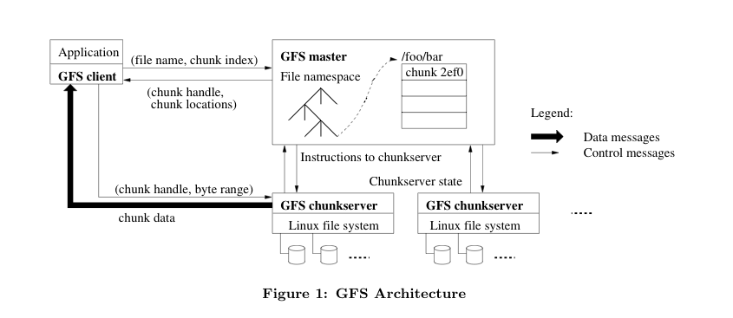
GFS Architecture
A cluster consists of a single master & multiple chunk-servers & is accessed by multiple clients

Slide 24
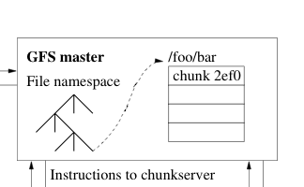
GFS Master
Maintains all file system metadata
  names space, access control info, file to chunk mappings, chunk (including replicas) location, etc.
Periodically communicates with chunk-servers in HeartBeat messages to give instructions and check state
Read/write: client contacts Master to get chunk locations, then deals directly with chunk-servers
Notes:
A heartbeat message is a message sent from an originator to a destination that enables the destination to identify if and when the originator fails or is no longer available.^{[1]} Heartbeat messages are typically sent non-stop on a periodic or recurring basis from the originator's start-up until the originator's shutdown. When the destination identifies a lack of heartbeat messages during an anticipated arrival period, the destination may determine that the originator has failed, shutdown, or is generally no longer available. Heartbeat messages may be used for high-availability and fault tolerance purposes

Slide 25
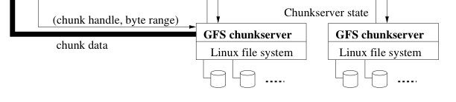
GFS Chunk-server
Files are broken into chunks. Each chunk has an immutable globally unique 64-bit chunk-handle
  handle is assigned by the master at chunk creation
Chunk size is 64 MB
Each chunk is replicated on 3 (default) servers

Slide 26
GFS Client
Linked to apps using the file system API
Communicates with master and chunk-servers for reading and writing
  Master interactions only for metadata
  Chunk-server interactions for data
Only caches metadata information
  Data is too large to cache

Slide 27
GFS Chunk Location
Master
  does not keep a persistent record of locations of chunks and replicas
Chunk-Servers
  Master polls chunk-servers at startup and when chunk-servers join or leave
HeartBeat Messages
  Stays up to date by controlling placement of new chunks and through HeartBeat messages (when monitoring chunk-servers)

Slide 28
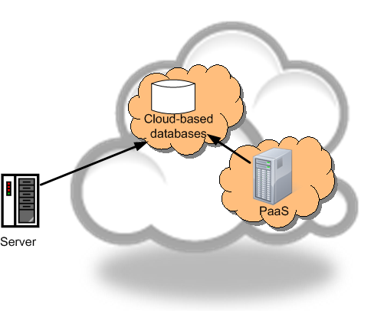
Cloud-based Databases
Databases
  Used by applications resided in the cloud
  Used by applications resided within the customer’s data centre

Slide 29
Advantages of using
Cloud-Based Databases
Cost-effective database scalability
  Scale dynamically
  Pay-as-you-go
High availability
  Reside on redundant hardware
High data redundancy
  DB replicated
Reduced administration
  Maintain the database updates and patches

Slide 30
Disadvantages of using
Cloud-Based Databases
Data security concerns
  …
Performance
  Data queries travel through the Internet

Slide 31
Cloud-Based Block Storage
Block of data storage
  Fixed-size of sequence of bits
  Size of block corresponds to an underlying unit of storage
  Applications with very large blocks of data
Cloud-based block storage device
  Amazon ESB
    Block size up to a terabyte
    Reliable, scalable
Notes:
Each block acts as an individual hard drive and is configured by the storage administrator. These blocks are controlled by the server-based operating system, and are generally accessed by Fibre Channel (FC), Fibre Channel over Ethernet (FCoE) or iSCSI protocols.
Because the volumes are treated as individual hard disks, block storage works well for storing a variety of applications such as file systemsand databases. While block storage devices tend to be more complex and expensive than file storage, they also tend to be more flexible and provide better performance.

